Slide 1
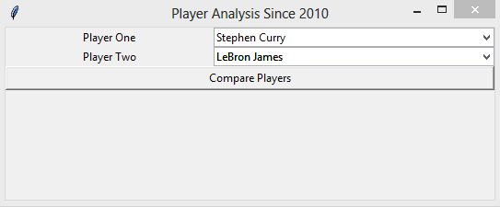

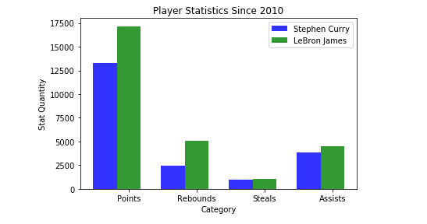
NBA Player Comparison: Total Fantasy Points Since 2010
Devin Martin, Joey Alfieri , Andy Sherman
Our Program
ProBasketballAPI.com
Problems and Area for Improvement
ProBasketballAPI.com is a free api service that has accumulated several statistics from the NBA since 2010. We decided that for our project the categories of points, rebounds, assists and steals would provide enough data to create a genuine comparison. This api required us to make a post request (PHP) instead of our typical get request.
We had trouble figuring out how to import the data and get the statistics to pull correctly. Once we figured out how to pull the stats, we then realized that the data only dated back to 2010. Also the stats aren’t by individual year, but instead all of the player’s stats since 2010. Since the data isn’t for each individual year, this creates various issues with comparing players with one another since some players have been playing longer than others. Another issue we had was not being able to sort the players alphabetically. This causes it to be difficult to find a specific player.
Using tkinter, numpy and matplotlib, we were able to create a player comparison tool that pulls player names and statistics from ProBasketballAPI.com
Our program allows the user to select from a generated list of NBA players out of a drop down menu and then compare them head-to-head. We utilized a bar graph to depict player comparison side by side to give the most concise comparison.
Modules Used
Tkinter - was used for most of the graphical portions of the program. All the buttons, windows, and connections after pressing a button were made with Tkinter.
Matplotlib was used for the actual graph . Numpy was used to create the drop down menu. It arranged the four groups in a list and partitioned them correctly for the bar charts/graphs that were built with Matplotlib.
Fantasy Basketball Correlation
With the data pulled from this api, we were able to add up individual stat totals across the four categories of points, rebounds, assists and steals. This sum of statistics determined who had accumulated more fantasy points since 2010. With this data, we then had our program provide a recommendation or opinion stating who the better player was based off of the total sum of their statistics.

